Slide 1
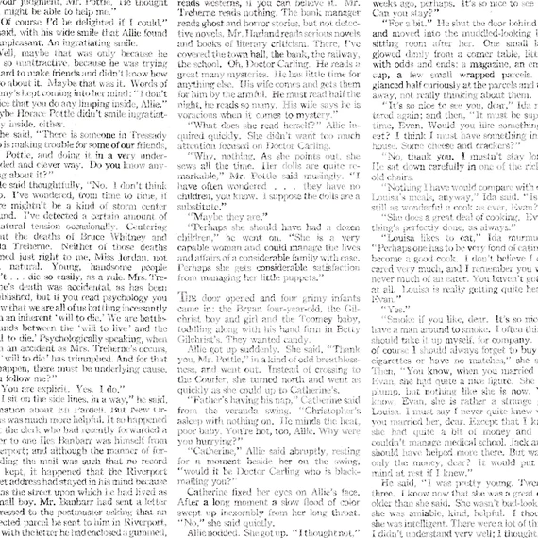
Blackout Poetry

Slide 2
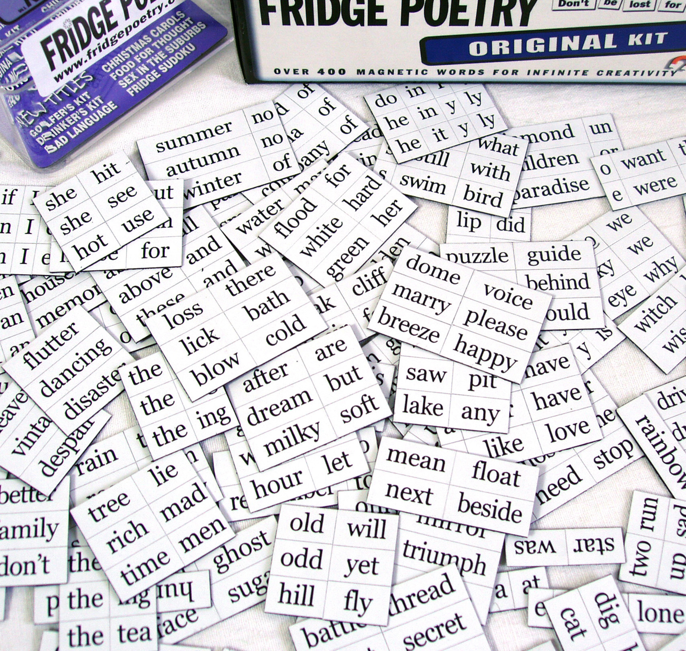
Found Poetry
Found Poetry - Poetry that is made entirely of outside sources
Types of found poetry include:
Collage poetry
Cento poetry (poems created from other poems)
Blackout poetry
In blackout poetry, people take a page of text and select specific words, blacking out the rest to create a poem with what remains.

Slide 3
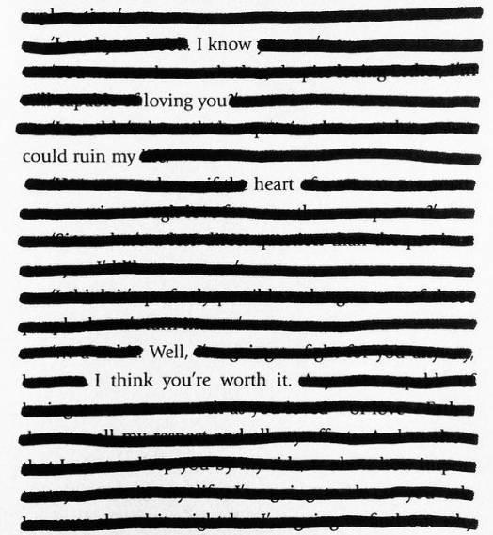
Examples: Regular Blackout Poems
I know loving you
Could ruin my heart.
Well, I think you’re worth it.

Slide 4
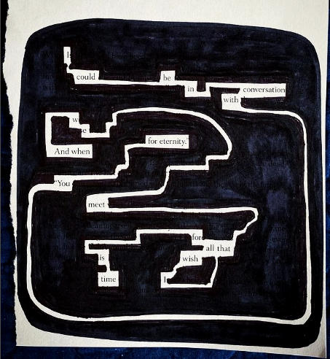
Examples: Trailing Blackout Poems
I could be in conversation with you for eternity.
And when we meet,
All that I wish for is time.
Note how the author separated letters to spell words!

Slide 5
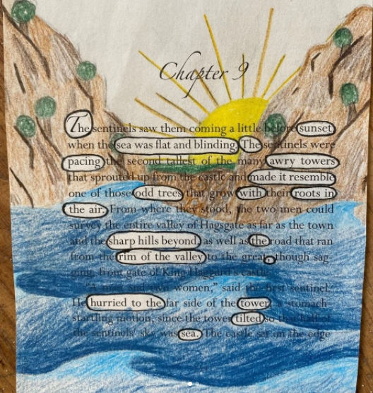
Examples: Artsy Blackout Poems
The sunset sea was flat and blinding
The pacing awry towers
Made it resemble odd trees with roots in the air
Sharp hills beyond the rim of the valley
Hurried to the tower tilted sea

Slide 6
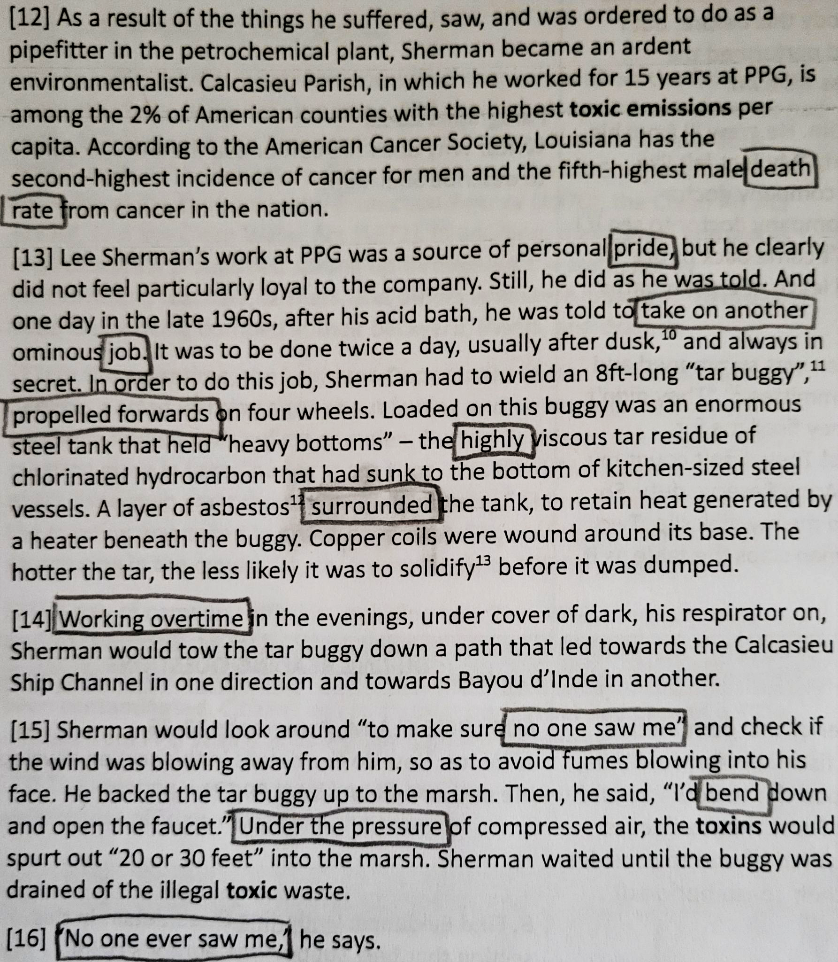
How to Create a Blackout Poem: Selecting the words
Choose the text you want to work with.
Read through your page and circle words that stand out to you in pencil.
You can repeat this step as many times as needed until you find a section with a lot of good words (especially with longer texts).

Slide 7
How to Create a Blackout Poem: Connecting the words
Look over all of your words. See what connections you can make between the words that you chose.
Remove any circled words that you don’t feel fit with the rest.

Slide 8
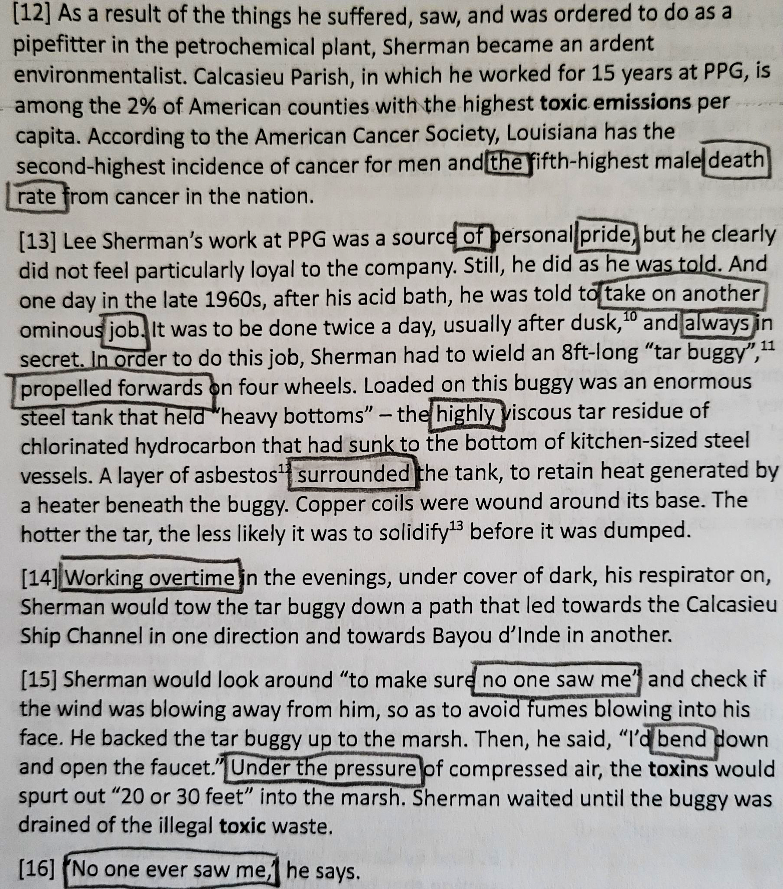
How to Create a Blackout Poem: Connecting the words
Look for any other words that may connect to the theme of your poem, along with connecting words that you can use to make phrases.
Examples of connecting words: a, the, is, this, etc.

Slide 9
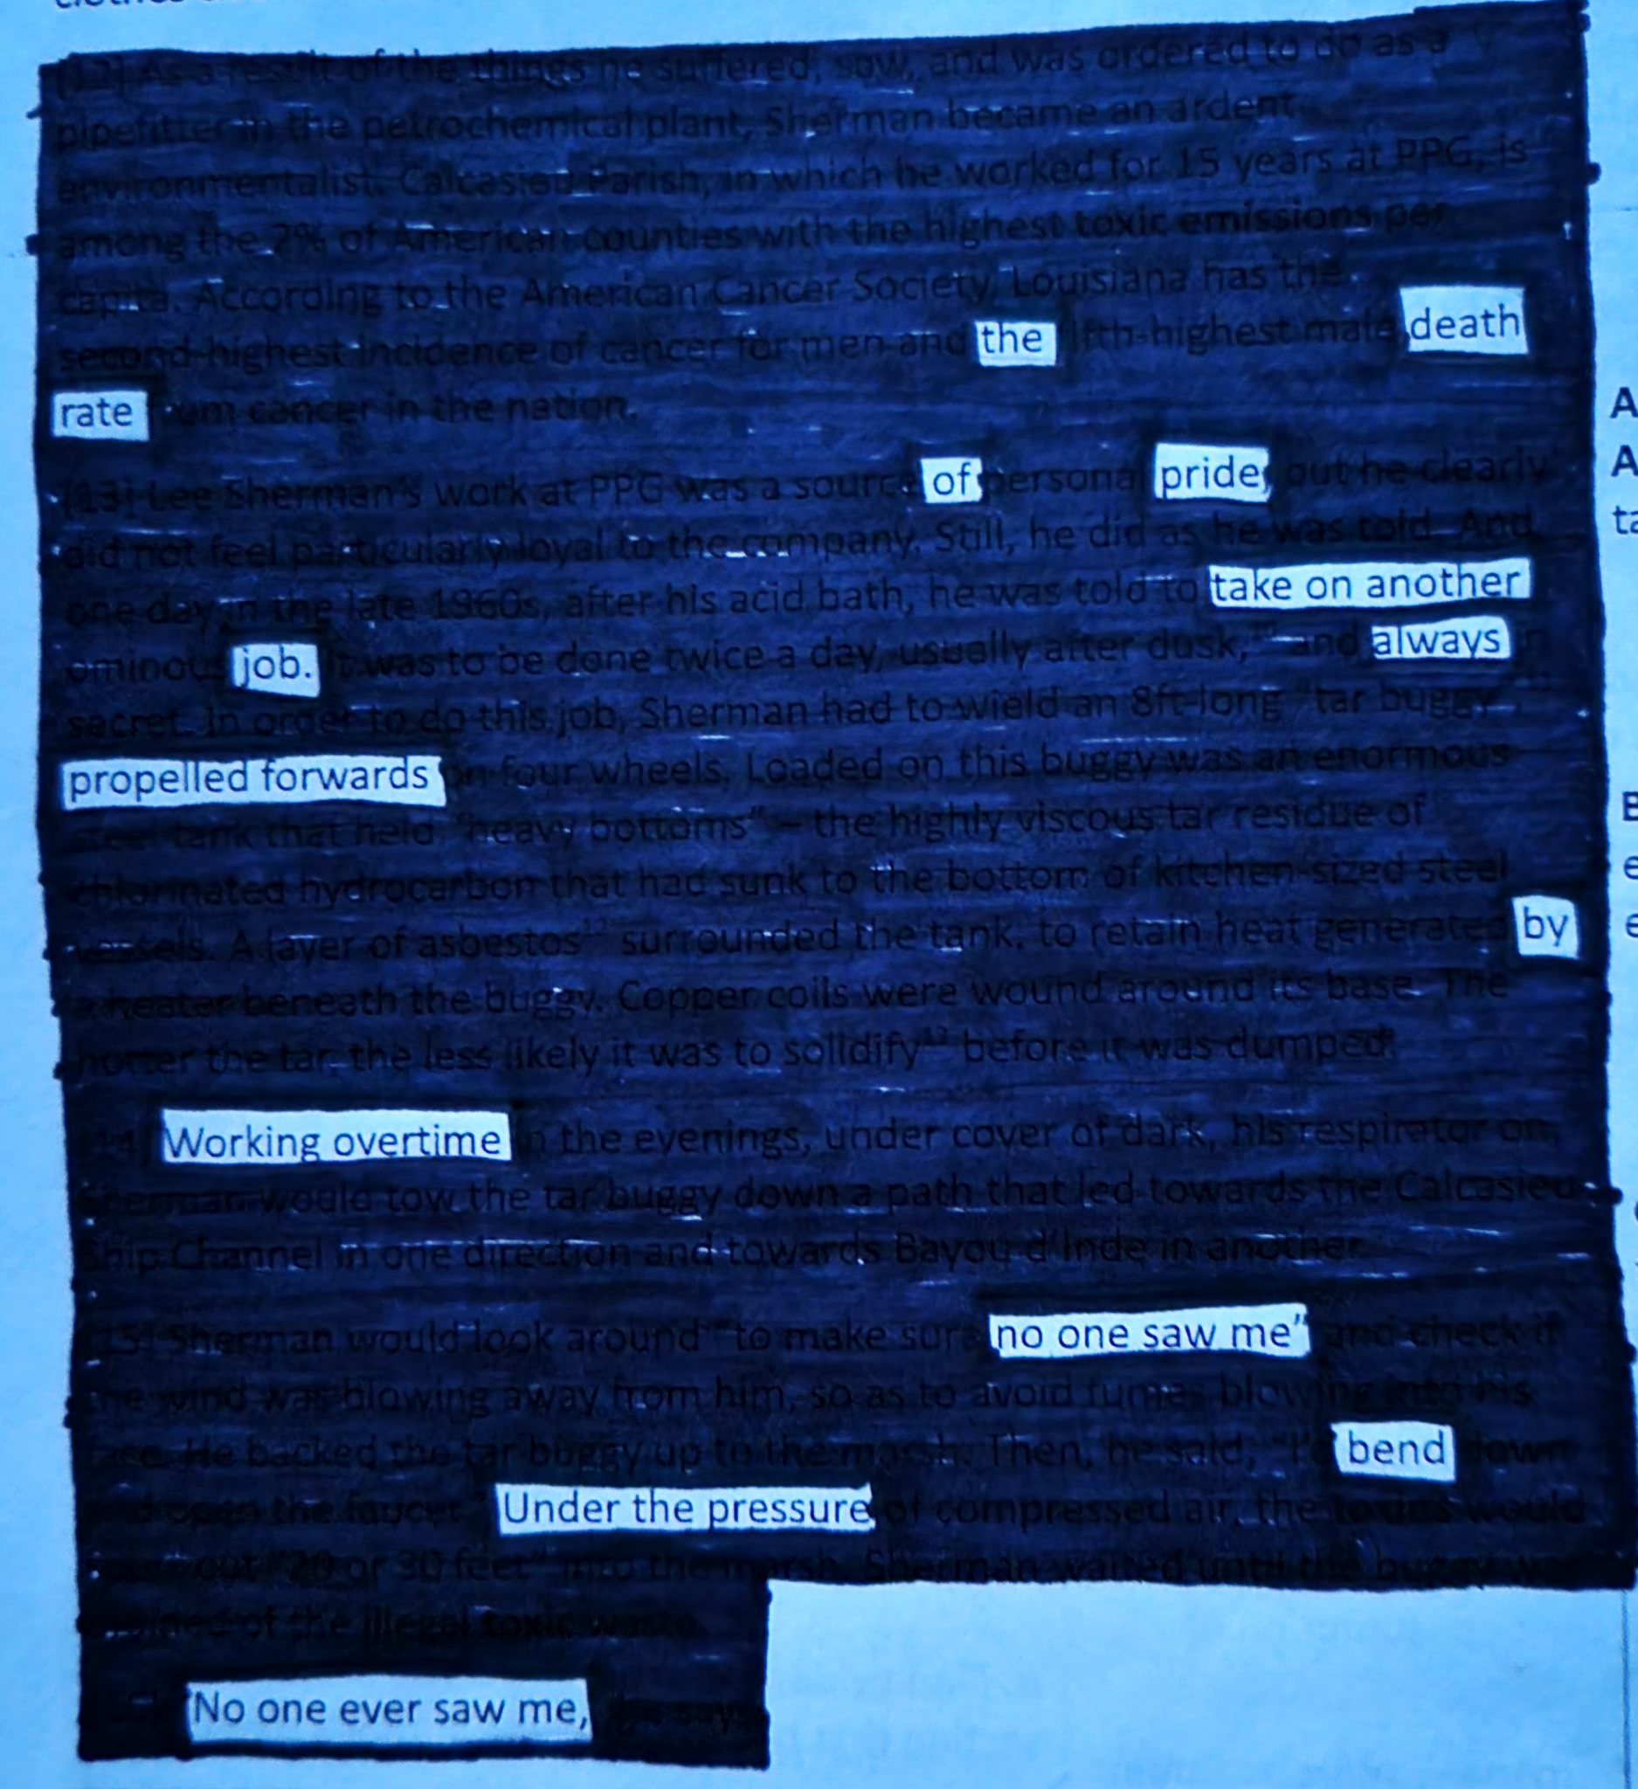
How to Create a Blackout Poem: Blacking out the background
Once your words are chosen, cover up the rest of the words with a sharpie.
Final Poem
The death rate of pride:
Take on another job,
Always propelled forward by working overtime.
No one saw me bend under the pressure.
No one ever saw me.

Slide 10
Review: Steps to Create a Blackout Poem
Pick a paper to work with
Find words that stick out to you
Connect your words and remove any that don’t fit
Find any connecting words you may need
Black out the rest of the words
Once you are finished, add a title to your poem!
Challenge: Your poem should somehow connect back to our unit: Insert your unit here

Slide 11
Exit Ticket: How did you like this activity?
On the whiteboard, write down:
Anything you liked about this activity
Anything you think could be improved about this activity

